Slide 1


Agricultural Micro-Loan Predictor
Empowering Kenyan Farmers and SACCOs with AI-Driven Credit Decisions

Slide 2
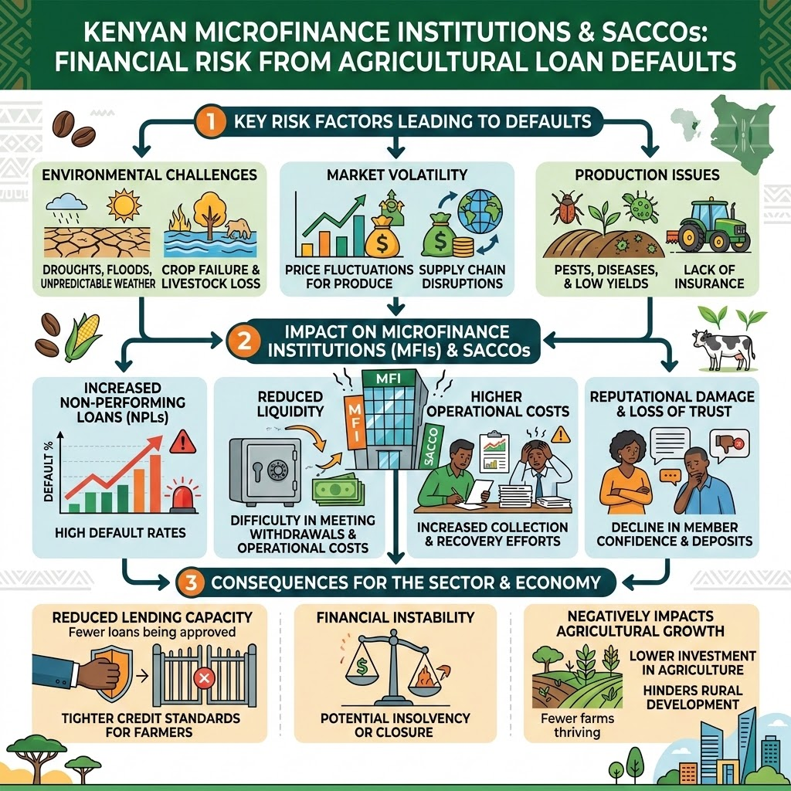


The Problem
Kenyan microfinance institutions and SACCOs face significant financial risk from loan defaults in the agricultural sector.
Manual credit assessments are slow, inconsistent, and prone to human bias.
Agricultural lending has inherently higher volatility due to seasonal, weather, and market risks.
~21.8% of loans default, creating significant financial losses for SACCOs.
Smallholder farmers lack formal credit histories, making traditional scoring models ineffective.

Slide 3
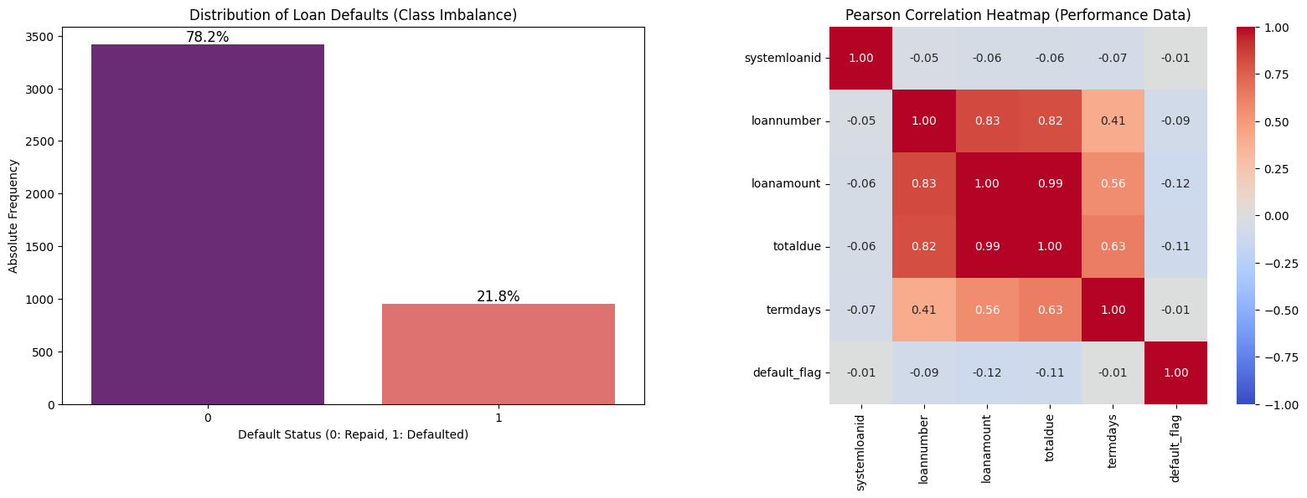
Dataset | Records | Features | Description
traindemographics | 4,346 | 9 | Age, employment, education, bank
trainprevloans | 18,183 | 12 | Historical loans, amounts, repayment dates
trainperf | 4,368 | 10 | Current loan performance + target
Dataset Overview
Three relational datasets from , linked by customerid

Slide 4



Methodology Overview
A systematic feature engineering workflow and preprocessing pipeline designed for credit prediction.
🔬 Behavioral Features
Repayment delay days
Late payment indicators
Interest accrued
Loan intensity (amount / term)
👥 Per-Customer
Total previous loans count
Average repayment delay
Late repayment ratio
On-time repayment rate
🏷️ Demographic Derivatives
Age at loan application
Employment status encoding
Education level encoding
Bank name target encoding
Feature Rationale
By combining raw demographics with aggregated repayment patterns, the model captures both static risk profiles and dynamic behavioral shifts.
⚙️ Preprocessing Pipeline
Using sklearn.compose. ColumnTransformer to isolate and target specific attribute types.
Numerical Features
Transformer: StandardScaler
lloan_amount, total_due, age_at_loan, mean_repay_delay
High-Cardinality Categorical
Transformer: TargetEncoder
bank_name_clients
Low-Cardinality Categorical
Transformer: OneHotEncoder
employment_status, bank_account_type, education_level

Slide 5





Solution Architecture
An end-to-end machine learning pipeline balancing predictive power with explainability.
1. Data Pipeline
2. Modeling
3. Explainable AI
Aggregated behavioral features (repayment delays, late payment ratios) and demographic derivatives. Applied Target Encoding and StandardScaler.
Evaluated PyTorch ShallowMLP, DeepTabNet, and XGBoost. Addressed class imbalance using SMOTE and optimal threshold tuning.
Integrated native SHAP (SHapley Additive exPlanations) values to provide per-prediction transparency for loan officers.

Slide 6
Model Architectures
Comparative summary of the three evaluated machine learning architectures for credit scoring.
★ PRIMARY MODEL
🌳 XGBoost Tuned
Gradient-boosted tree ensemble — production model
🧠 ShallowMLP
PyTorch neural network benchmark
🔮 DeepTabNet
Deep tabular comparison model
Search strategy
RandomizedSearchCV
Cross-validation
3-fold CV Folds
Total Iterations
15 hyperparameter trials
Layer Architecture
Input → 128 → 64 → 1
Activation functions
ReLU + BatchNorm
Regularization
30% Dropout
Layer Architecture
256 → 128 → 64 → 32 → 1
Activation functions
LeakyReLU
Regularization
Heavy Dropout rate
0.724
VALIDATION AUC-ROC
0.694
VALIDATION AUC-ROC
0.716
VALIDATION AUC-ROC

Slide 7
End-to-End Pipeline Architecture
Schematic overview of the credit scoring data, modeling, deployment, and explainability workflow.
STEP 01
📦 Raw Data
3 CSV datasets containing customer and historical loan profiles.
STEP 02
⚙️ Feature Eng.
Creation of 20 behavioral and demographic features.
STEP 03
🔄 Preprocessing
ColumnTransformer pipelines applied for numerical & categorical encoding.
STEP 04
🤖 Training
XGBoost optimization and deep tabular network training.
STEP 05
🌐 Deployment
Live web app powered by Streamlit for instant visual evaluation.
STEP 06
🔍 SHAP Explainer
Provides per-prediction transparency for credit analysis.
STEP 07
✅ Risk Decision
Automated determination on whether to approve or flag the application.

Slide 8

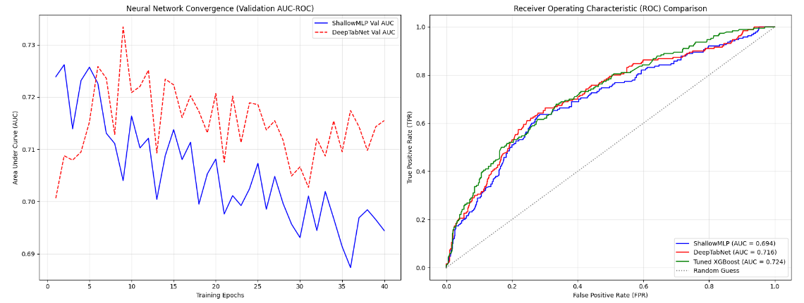
Model Performance Evaluation
XGBoost Tuned Ensemble achieved the strongest overall performance on validation datasets.

Slide 9

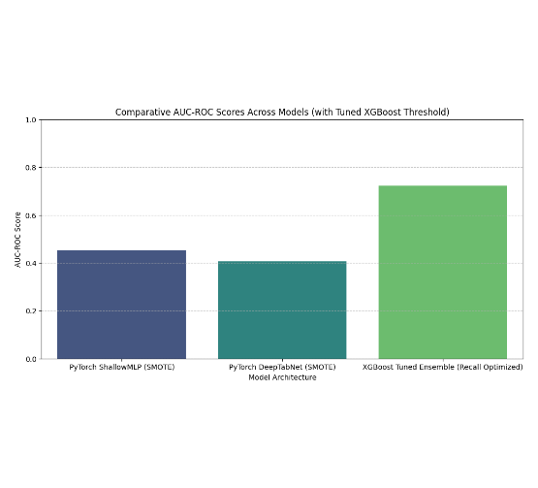
Addressing Class Imbalance
Threshold Tuning > SMOTE
With an initial ~80/20 class imbalance, traditional models struggled to identify the minority class (Defaulted loans).
Cost-sensitive weighting and SMOTE were applied to augment minority representation; specifically, scale_pos_weight in XGBoost penalizes misclassifying defaults more heavily than repaid loans.
Optimization: Adjusting the classification threshold from the default 0.5 down to ~0.10 - 0.35 proved most effective.
This significantly improved Default Recall without drastically over-penalizing good borrowers.

Slide 10
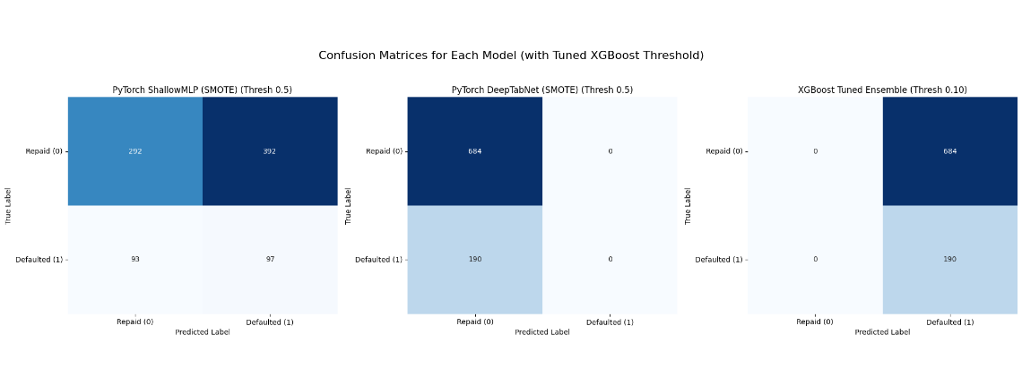
Optimizing Default Recall
The Tuned XGBoost model with threshold optimization dramatically shifted false negatives into true positives for defaults.

Slide 11
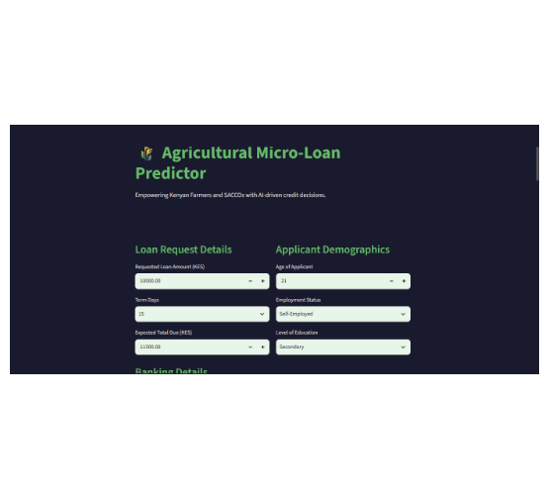
Interactive XAI Dashboard
Real-Time Risk Assessment
The Streamlit web application allows loan officers to input applicant demographics and loan request details to receive instant predictions.
Color-coded outputs (High Risk / Low Risk)
SHAP Explanations showing the top 10 factors influencing the specific decision.
Narrative summaries translating ML outputs into plain English.

Slide 12


Key Findings & Responsible AI
Primary Risk Drivers
Responsible AI Practices
Repayment Behavior: mean_repay_delay and late_repayment_ratio are the strongest predictors.
Explainability (No Black Box): SHAP integration ensures every prediction is transparent.
Loan Intensity: High requested amounts over short term periods correlate highly with default.
Fairness Audits: Disaggregated performance analysis across employment sub-groups to check for algorithmic bias.
Feature Engineering: Engineered behavioral features significantly outperformed raw demographics.
Decision Support: Positioned purely as an advisory tool, not a replacement for human judgment.

Slide 13
Ethics & Responsible AI Framework
🔍 Explainability
Every prediction includes SHAP-based feature impact analysis.
Loan officers see exactly why each decision was made — ensuring complete clarity rather than relying on a complex black box.
⚖️ Fairness Audit
Disaggregated AUC-ROC performance analysis.
Consistent mathematical verification across diverse employment sub-groups: Permanent, Self-Employed, Student, Unemployed, and Retired.
📢 Transparency Disclaimer
Strict policy-driven algorithmic guardrails.
Every prediction page prominently displays: "AI is a decision-support tool—not a replacement for human judgment and regulatory guidelines."
🧩 No Black Box
Traceable feature contributions for key factors.
The system explicitly maps out how loan amount, repayment history, and employment details influenced each decision, building deep trust.

Slide 14

Insights: Key Findings & Takeaways
01
Top Risk Drivers
Repayment delays (mean_repay_delay, max_repay_delay), late_repayment_ratio, and high loan intensity are the strongest predictors.
02
Threshold Tuning > SMOTE
Adjusting classification threshold (0.5 → ~0.25) was more effective than SMOTE alone for catching actual defaults.
03
XGBoost > Neural Networks
Tuned XGBoost consistently outperformed both ShallowMLP and DeepTabNet on this tabular dataset — gradient boosting remains king for structured data.
04
Feature Engineering Matters
Engineered behavioral features (repayment delay ratios, on-time rates) had far higher predictive power than raw demographic features alone.

Slide 15






Thank You
Empowering farmers, one loan at a time 🌾
Project Resources
🌐 Live Demo ↗
Explore the interactive Streamlit agricultural credit scoring application in real-time.
📂 GitHub Repo ↗
Review the source code, Python notebooks, and pipeline implementation details.
Technology Stack
Engineered using modern machine learning frameworks and interactive web technologies:
Python 3.12+XGBoostPyTorchSHAPStreamlitSMOTE

